Slide 1
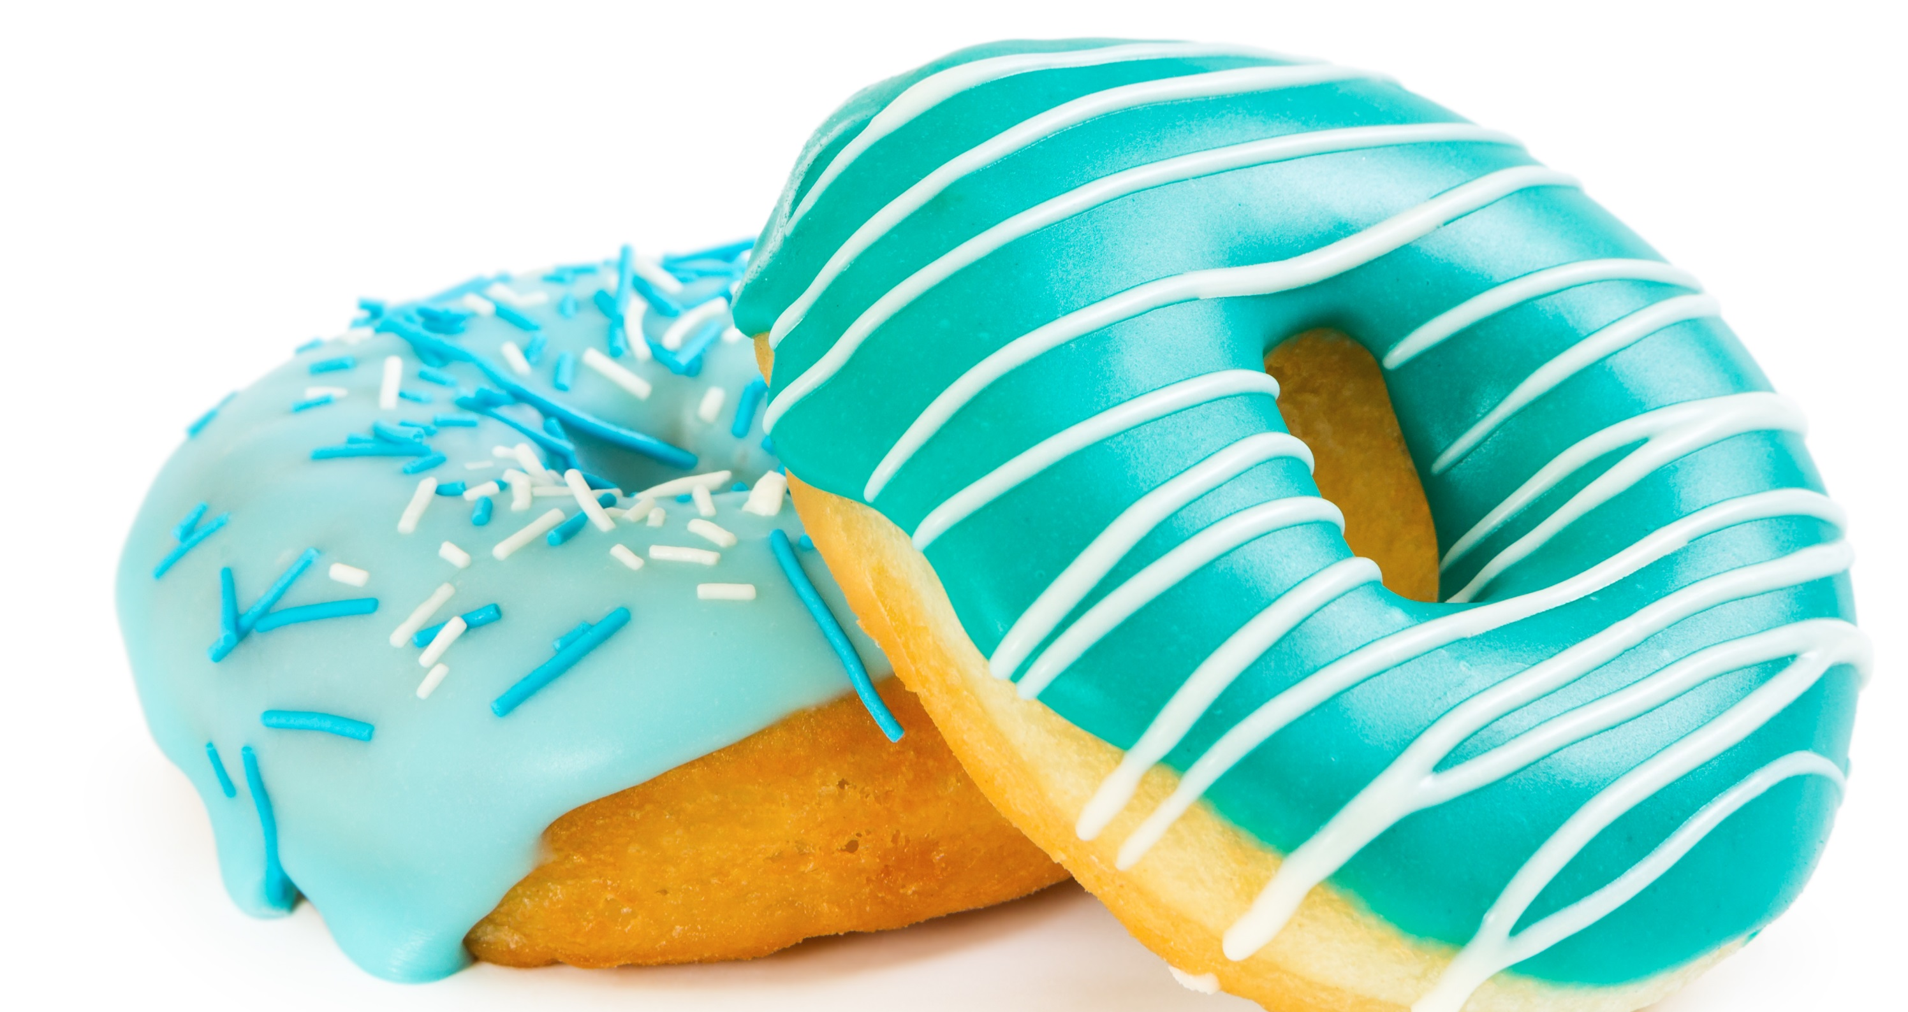
FREE Vancouver Training
FACEBOOK
TM
ADS
That Work!

Slide 2
FREE Vancouver Training
FACEBOOK
TM
ADS
That Work!

Slide 3
FREE Vancouver Training
FACEBOOK
TM
ADS
That Work!

Slide 4
FREE Vancouver Training
FACEBOOK
TM
ADS
That Work!

Slide 5
FREE Vancouver Training
FACEBOOK
TM
ADS
That Work!

Slide 6
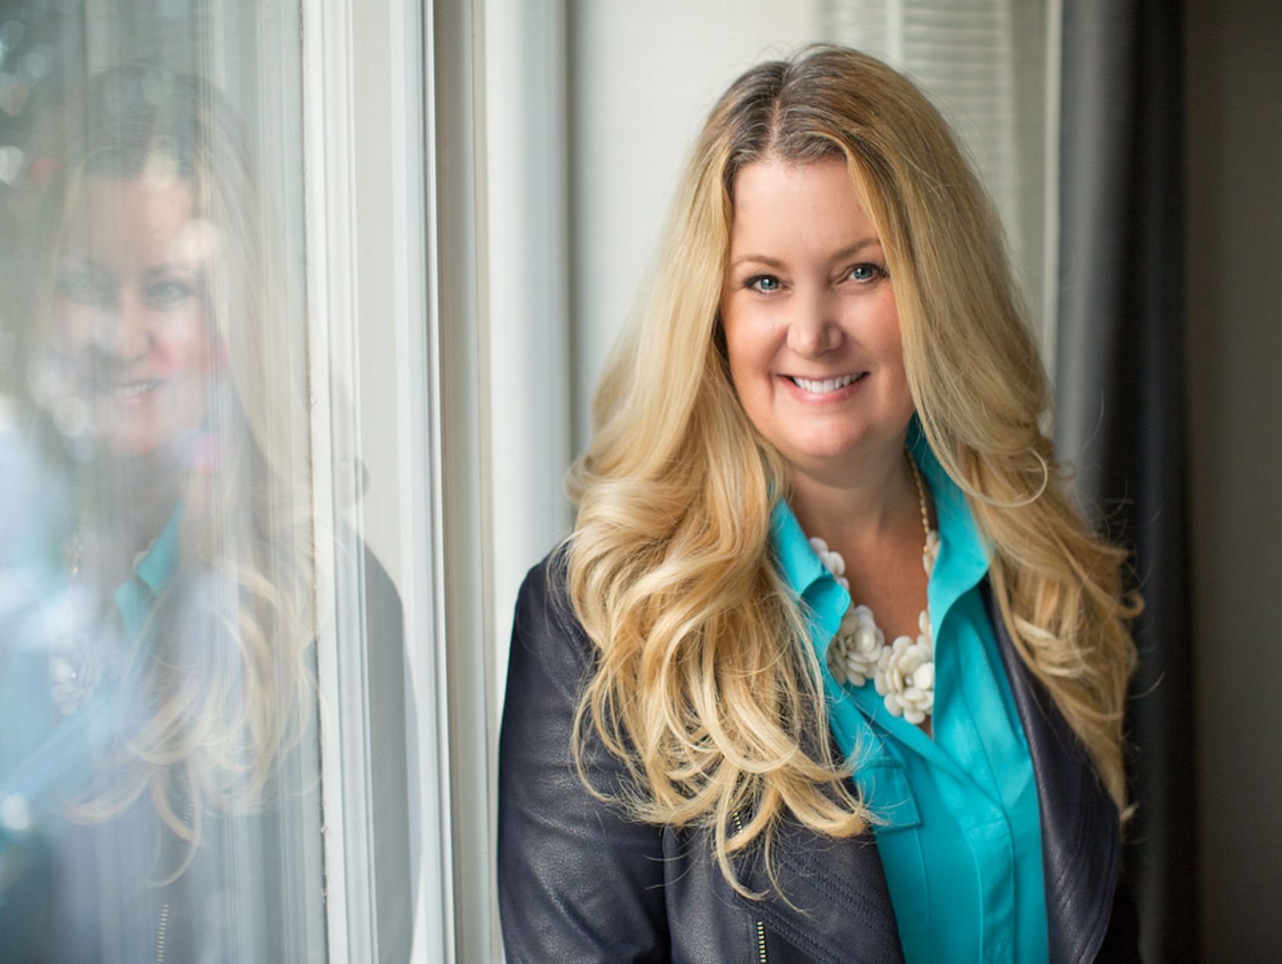
FACEBOOK
TM
ADS
That Work!
FREE Vancouver Workshop

Slide 7
Vancouver Training
FACEBOOK
TM
ADS
That Work!

Slide 8
FACEBOOK
TM
ADS
That Work!

Slide 9
FACEBOOK
TM
ADS
That Work!

Slide 10
TM

Slide 11
FACEBOOK
TM
ADS
That Work!
FREE Vancouver Training

Slide 12
FREE Vancouver Training
FACEBOOK
TM
ADS
That Work!

Slide 13
FREE Vancouver Training
FACEBOOK
TM
ADS
That Work!
Create an automatic flow of clients using Facebook Ads!

Slide 14
FREE Vancouver Training
FACEBOOK
TM
ADS
That Work!
Create an automatic flow of clients using Facebook Ads!

Slide 15
FREE Vancouver Training
TM
FACEBOOK
ADS
That Work!

